Slide 1
MTA Data Analysis of NYC Subway for WTWY
Ersin SÜER
First Project for the Bootcamp,
Istanbul Data Science Academy
04/10/2022

Slide 2
OBJECTIVES
Our goal is to help WTWY teams in achieving maximum email signups.
To able to interact with the max. number of people in NYC.

Slide 3
SOLUTION
We will determine the locations and times with the busiest human traffic by using NYC MTA turnstile datas:
http://web.mta.info/developers/turnstile.html

Slide 4
from 26FEB to 20MAY (12 weeks)
http://web.mta.info/developers/data/nyct/turnstile/turnstile_220305.txt
http://web.mta.info/developers/data/nyct/turnstile/turnstile_220312.txt
http://web.mta.info/developers/data/nyct/turnstile/turnstile_220321.txt
.
.
.
http://web.mta.info/developers/data/nyct/turnstile/turnstile_220520.txt
We concate all these 12 files in a ‘suitable’ way!

Slide 5
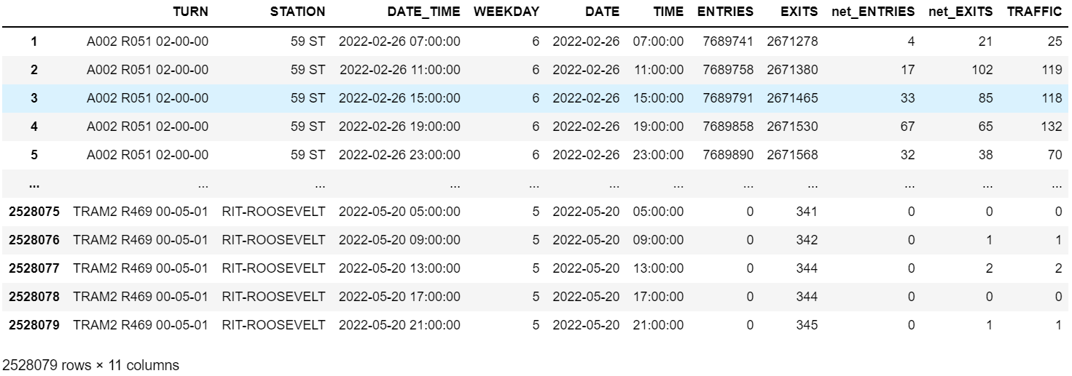
SOME MANIPULATIONS
CONCATE SOME COLUMNS : TURN = C/A + UNIT + SCP → call it by ‘turnstile ID code’
CONVERT DATATYPE : DATETIME FORMAT
ADD NEW COLUMNS : NET_ENTRIES,NET_EXITS, TRAFFIC, WEEKDAY
REMOVE UNNECESSARY COLUMNS: LINENAME,DIVISION,DESC

Slide 6
UNDERSTANDING DATA
Number of rows (number of audits for turnstiles): 2.528.079
Number of stations: 378
Number of turnstile: 5044

Slide 7
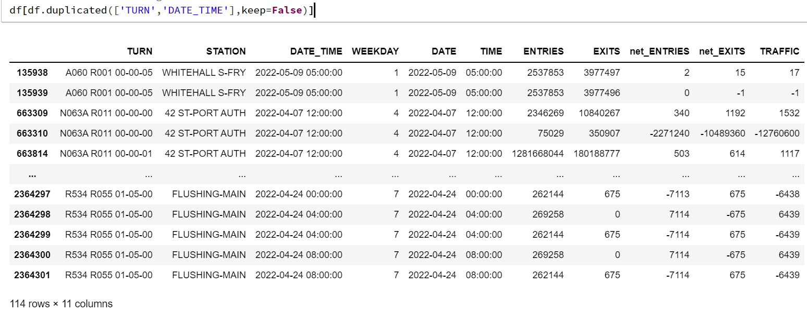
1- DETECTING DUPLICATED RECORDS

Slide 8
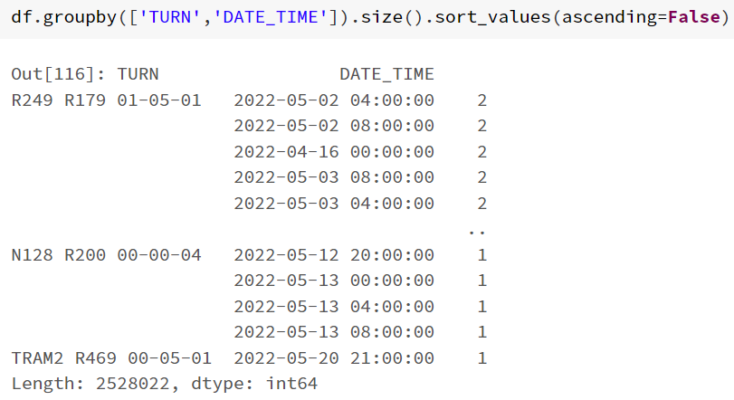
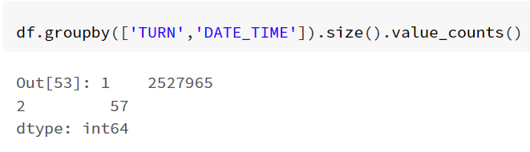
Corollary : For 57 number of turnstile, there are double records. So we have to remove 57 rows!

Slide 9
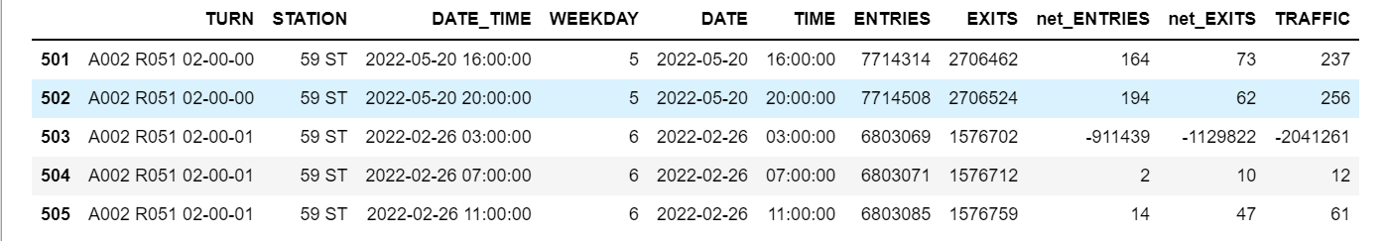
2- DETERMINE PROBLEMATIC RECORDS Step 1:
While concating dataframes, we automatically calculate net_entries/exits INCORRECTLY !
Question: How many such row are there?

Slide 10
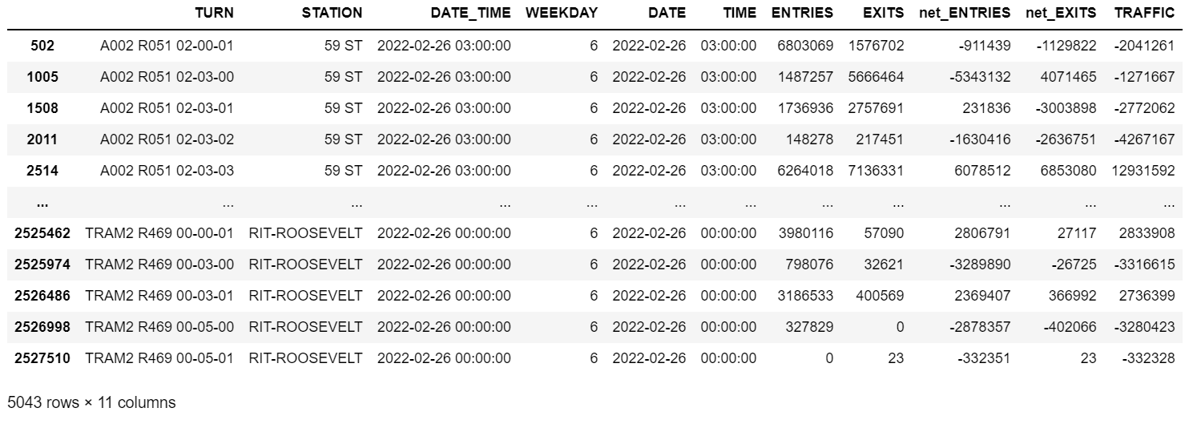
There exists 5043 number of such rows!
These datas are generally recorded at the very early mornings (mostly between 00:00 and 04:00 am). So removing these rows does not cause a big crisis!

Slide 11
2- DETERMINING PROBLEMATIC RECORDS Step 2:
We still have outliers in our data :
Find all rows with negative or huge positive records for net_ENTRIES and net_EXITS to determine outliers.
The number 10,000 looks a reasonable bound for being huge.

Slide 12
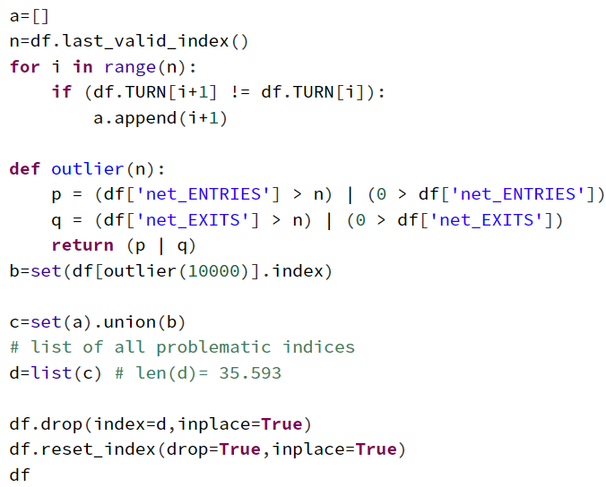
2- DETERMINING PROBLEMATIC RECORDS
Remove all negative and huge positive records
We assumed that 10,000 is a bound for net_ENTRIES and net_EXITS to determine outliers.
So we have 35,593 outliers in the whole dataframe.
Only 1.4 percent of our data will be lost.

Slide 13
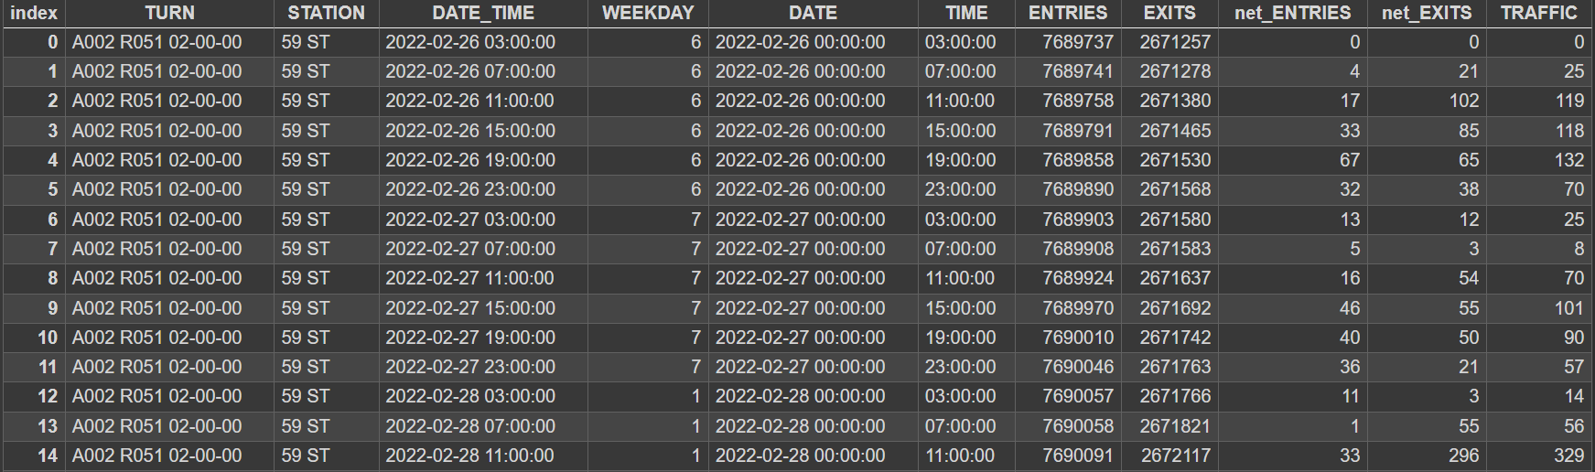
AFTER CLEANING DATA
WE ARE READY TO ANALYSIS

Slide 14
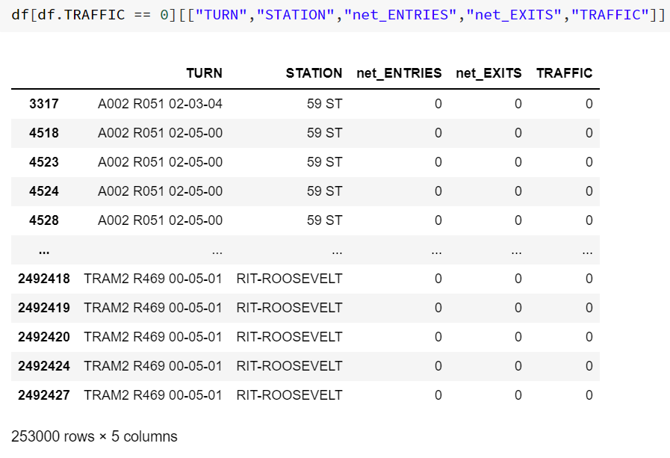
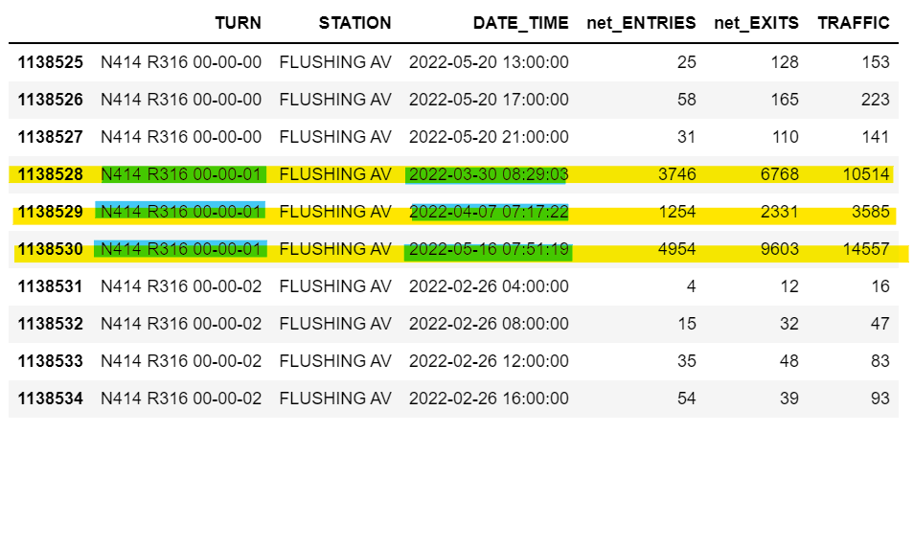
253,000 rows with 0 traffic records which consists of 10.1 percent of all our data!
Non-regular audits!
- PROBABLY DUE TO MAINTENANCE -

Slide 15
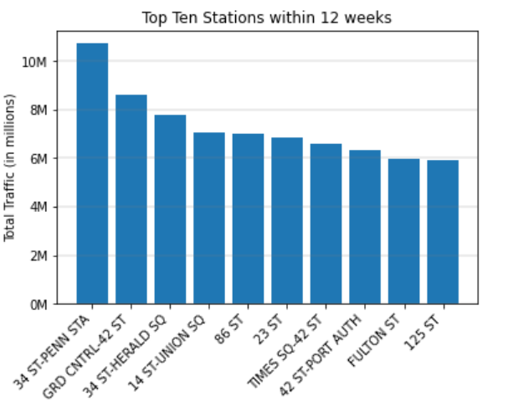
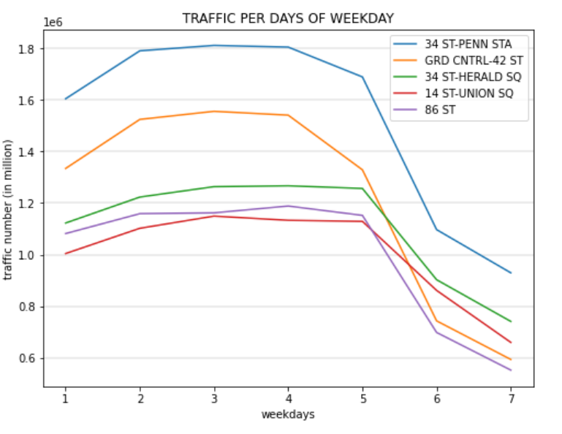
TOP TEN STATIONS

Slide 16
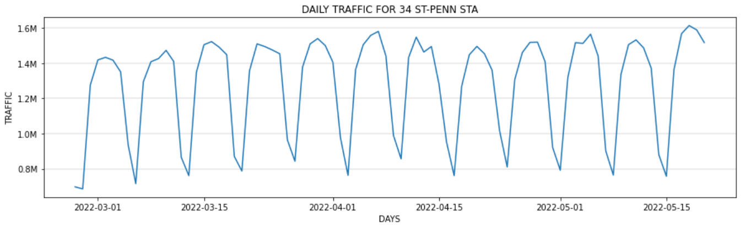
DAILY TRAFFIC FOR THE BUSIEST STATION

Slide 17
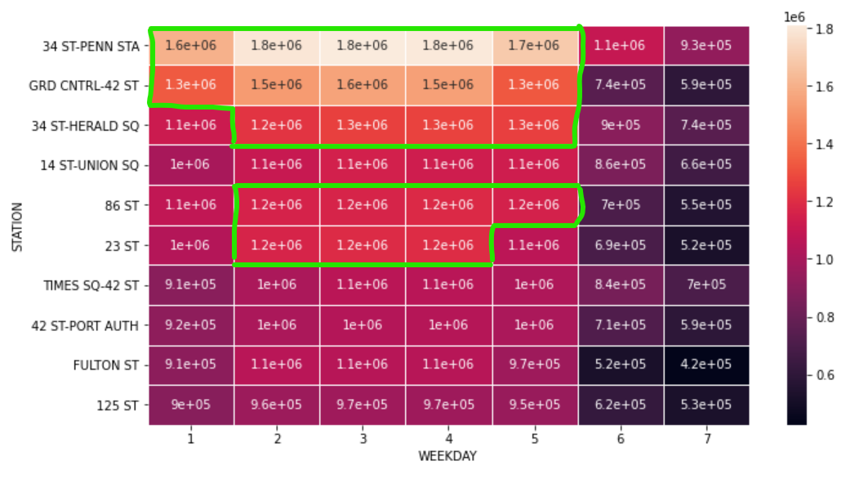
Key Findings
Weekends generally see less traffic
Weekdays generally see more traffic
Wednesday generally see more traffic

Slide 18

Thank You

